Slide 1
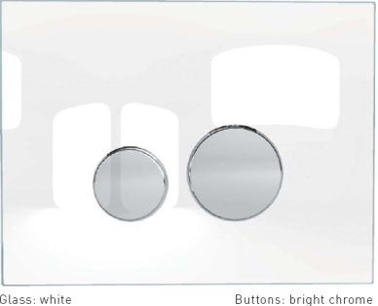
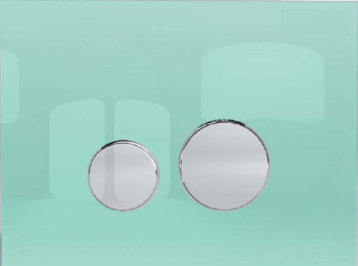
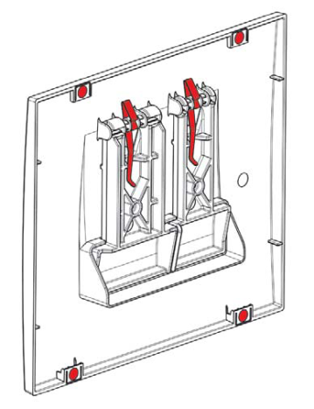
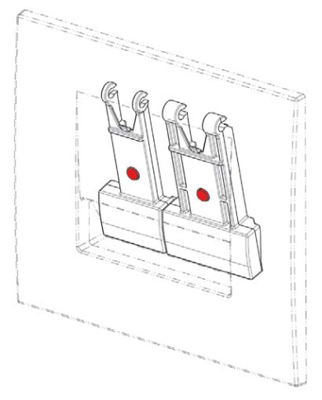
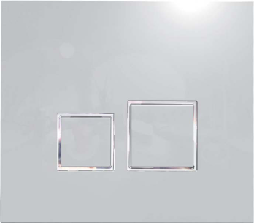
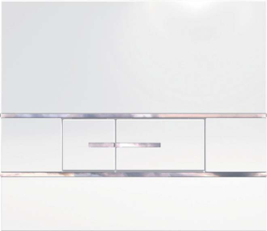
NEW TRENDY DESIGNS FOR SIAMP CONCEALED CISTERN DUAL FLUSH PLATE
PRODUCT USP’s
New Flush Control Plates are available in three models Segment, Square & Reflet 360
Silent: Shock absorbers on buttons back, smooth actuating screws
Stability: Dampers at the back of the frame to prevent movement
Design: Metal springs for buttons perfect alignment with plate
Comfort: Accurate and guileless actuation feeling with metal springs
Reflet 360 white/Chrome
Reflet 360 Frosted Green/Chrome
Square White/Chrome
Square Chrome
Segment White

Slide 2
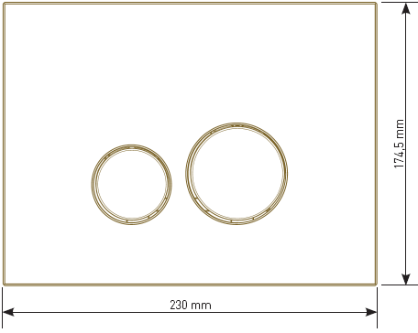
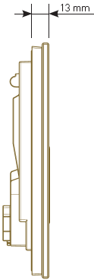
DUAL FLUSH PLATE - R E F L E T 3 6 0
FROSTED GREEN / CHROME
Cat No. CIS-CHR-31199219
MRP: 6200/-
WHITE / CHROME
Cat No. CIS-CHR-31199019
MRP: 5900/-
DESCRIPTION
Modern and round design
Decorated glass plate with light and depth effects
Toughened glass
Decorated ABS buttons
Double flush
Mechanical actuation
Smooth actuating screws to avoid operating noise
Hand cuttable fixing and actuation screws for adapting length to cladding
Can be used as hatch for reaching cistern equipment
Cladding thickness between 20 and 100 mm.
Frame back pads to allow support on the cladding

Slide 3

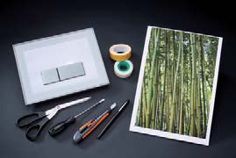
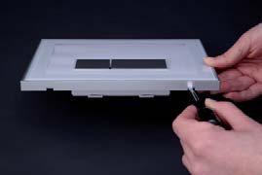
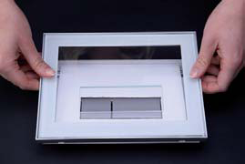
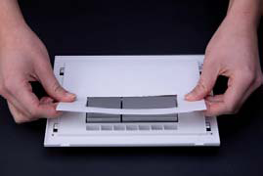



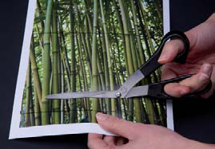
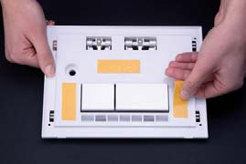
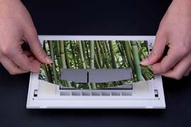
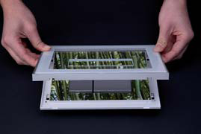
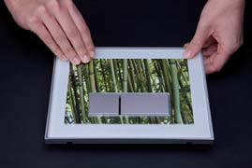
DUAL FLUSH PLATE - R E F L E T 3 6 0
Step for customizable Dual Flush Plate :
Customizable version: Can be customized with 1 mm. thick print (pictures, poster, print, wall paper,...),

Slide 4
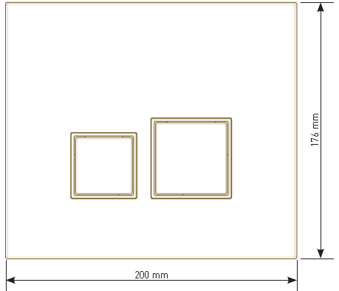
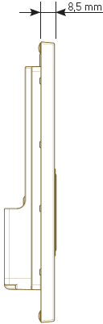
DUAL FLUSH PLATE - S Q U A RE
WHITE / CHROME
Cat No. CIS-CHR-31204019
MRP: 2400
ALL CHROME
Cat No. CIS-CHR-31207219
MRP: 3200
DESCRIPTION
Modern and angular design
Made from ABS
Double flush
Mechanical actuation
Actuation force below 20 Newton
Smooth actuating screws to avoid operating noise
Hand cuttable fixing and actuation screws for adapting length
to cladding
Can be used as hatch for reaching cistern equipment
Cladding thickness between 16 and 100 mm.
Frame back pads to allow support on the cladding

Slide 5
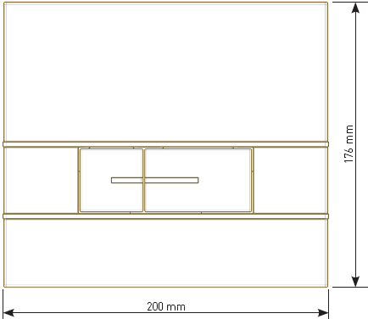
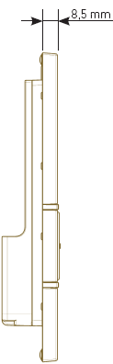
DUAL FLUSH PLATE - S E G M E N T
WHITE / CHROME
Cat No. CIS-CHR-31171019
MRP: 2400
DESCRIPTION
Modern design underlined by chrome inserts
Made from ABS
Double flush
Mechanical actuation
Actuation force below 20 Newton
Smooth actuating screws to avoid operating noise
Hand cuttable fixing and actuation screws for adapting length to cladding
Can be used as hatch for reaching cistern equipment
Cladding thickness between 16 and 100 mm.
Frame back pads to allow support on the cladding

